Slide 1
MARKS TO CSV v2
Mini Project Presentation : Zeroth Review
Guided by: Ms. JABIN MATHEW
Assistant Professor, Department of AD
Presented By :
Ms. ANEETA JOSE, SJC21AD013
Mr. DON SABU, SJC21AD024
Mr. JACOB PHILIP, SJC21AD029
Mr. PRANAV P, SJC21AD049
February 29, 2024
Department of AD (Mini Project : ADD 334)
February 29, 2024 1/13

Slide 2
Outline
Outline
Introduction
Where they left of
Objectives
Our plan
Technical Glimpse
Current status
Project Timeline
References
Conclusion
Department of AD (Mini Project : ADD 334)
February 29, 2024 2/13

Slide 3
Introduction
Outline
Marks2CSV is an initiative of a team from our preceding batch consisting of Ajay, Justin, Emil, Vishnuprasad under the mentorship of Dr. Deepa V
It aimed to streamline post-evaluation documentation efforts.
Version 1 achieved significant results, highlighting future potential and motivating continued development to support our faculty.
Department of AD (Mini Project : ADD 334)
February 29, 2024 3/13

Slide 4
Where they left of
Outline
Marks To CSV v1 achieved the following:
Transforms handwritten marks into structured CSV files.
Interprets marks ranging from 0 – 7, including instances with no awarded marks.
Model capable of analysing 5 papers within 13 seconds.
Model delivered an accuracy of 99.2%
Outputs are in machine as well as human friendly CSV format, ensuring easy readability and editability.
Department of AD (Mini Project : ADD 334)
February 29, 2024 4/13

Slide 5
Objectives
Outline
Scale up the model’s capability to recognize digits up to 14 including fractional marks
A validation system to cross check the marks providing real time outputs
Develop a more seamless method to interact with the system and provide efficient processing of data.
Department of AD (Mini Project : ADD 334)
February 29, 2024 5/13

Slide 6
Our Plan
Outline
Image of Answer sheet
Preprocessing
Warp Image to get only answer sheet
Convert to greyscale
Add threshold
Detect table and extract each cell
CNN Model for Segmentation and OCR
Output
Display the detected table
Export to CSV
Department of AD (Mini Project : ADD 334)
Department of AD (Mini Project : ADD 334)
February dd, 2024 2/15
February 29, 2024 6/13

Slide 7

Technical Glimpse
Outline
Segmentation and Detection of Double Digits
CNN Model for OCR
2
CNN Model Segmentation
2.5
0.5
Department of AD (Mini Project : ADD 334)
February 29, 2024 7/13

Slide 8
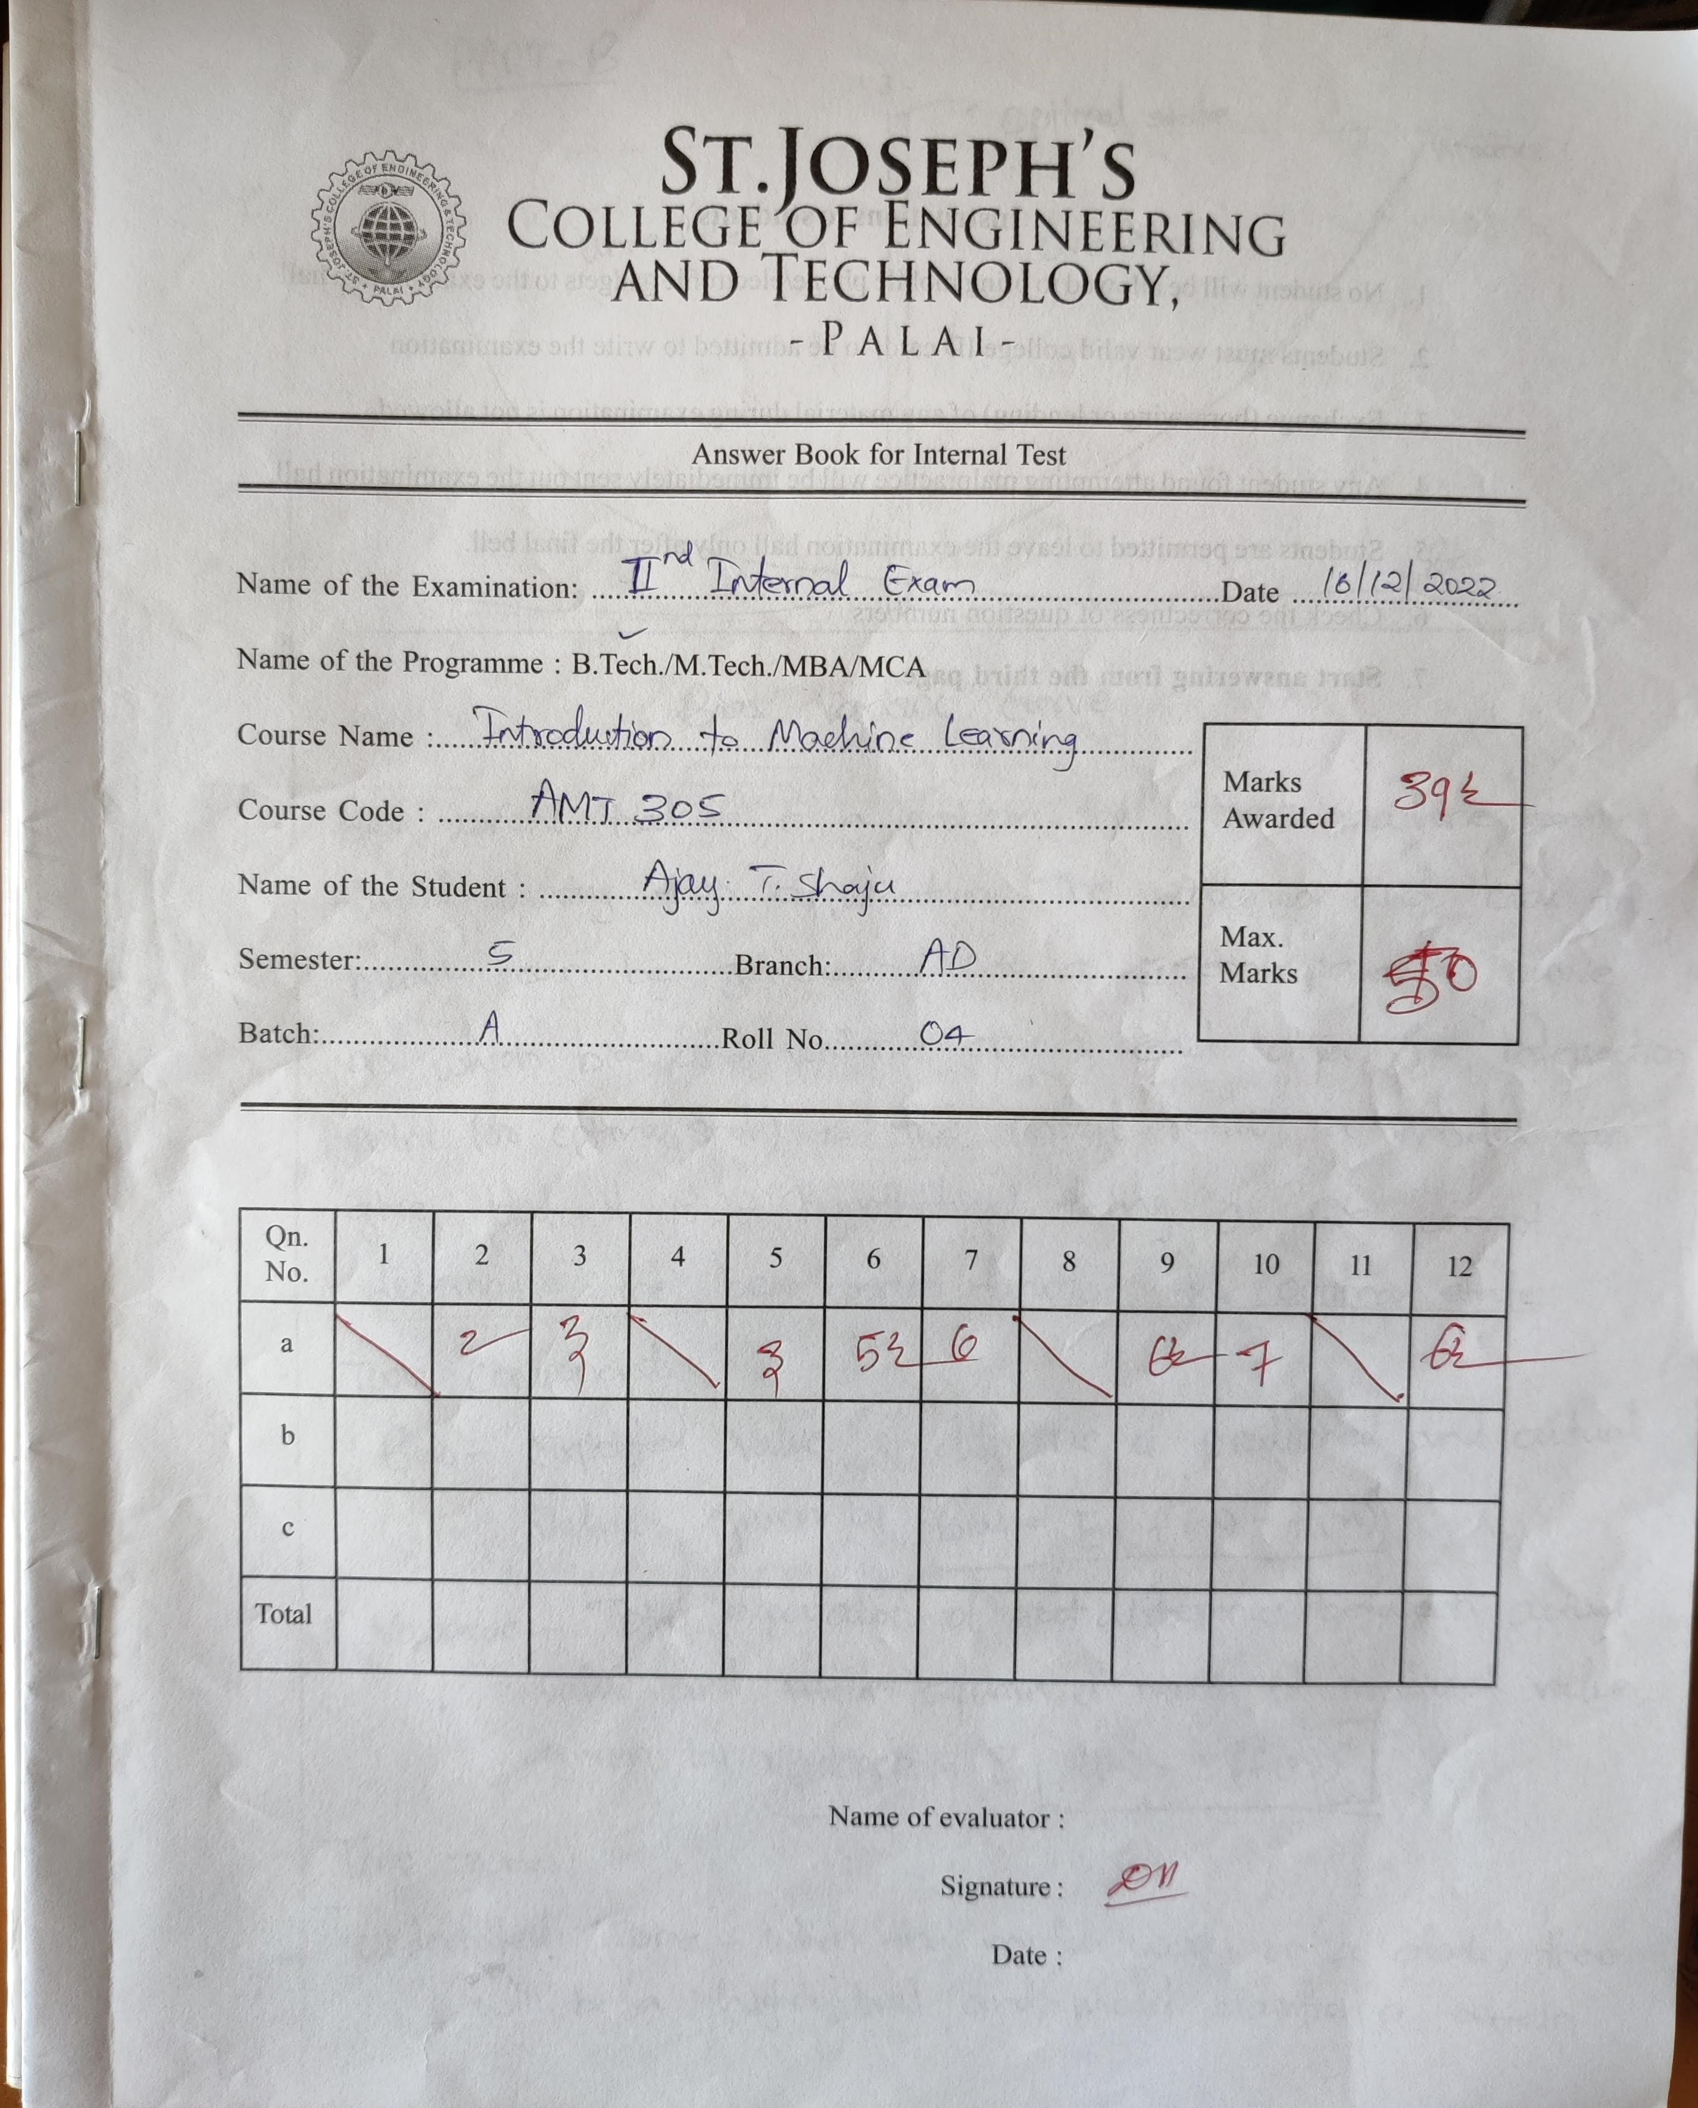
Technical Glimpse
Outline
Validation System
Input
Output to be Displayed
Display the detected marks in the same table format.
Show the cells that has less confidence while detection
Qn No | 1 | 2 | 3 | 4 | 5 | 6 | 7 | 8 | 9 | 10 | 11 | 12
a |  | 2 | 3 |  | 3 | 5.5 | 6 |  | - | 7 |  | -
b
c
Tot
Department of AD (Mini Project : ADD 334)
February 29, 2024 8/13

Slide 9
Current Status
Outline
We’ve consulted with the former batch and gathered their inputs and feedbacks.
Trained a CNN model based on the inputs gathered and scaled up the scope to digits upto 9, including fractional marks. However, model is overfit due to lack of data.
We’re in the process of collecting more data for half marks. Currently we have around 200 instances for each, but we would need significantly more.
Department of AD (Mini Project : ADD 334)
February 29, 2024 9/13

Slide 10
Project Timeline
Outline
Achieved Milestones
First Team Meeting
Consulted former batch
Abstract Submitted
Experimented on CNN Models
15/01/2024
24/01/2024
29/01/2024
20/02/2024
Future Deadlines
Complete Data Collection and Pre - Processing
Train new model for digits up to 14
Final CNN Model
By 11/03/2024
By 20/03/2024
By 29/03/2024
Implement to a usable form
Testing Phase
Final Release
By 12/04/2024
By 22/04/2024
By 26/04/2024
Department of AD (Mini Project : ADD 334)
February 29, 2024 10/13

Slide 11
References
Outline
[1] Ian J. Goodfellow, Yaroslav Bulatov, Julian Ibartz, Sacha Arnoud, Vinay Shet, "Mutli-digit Number Recognition from Street View Imagery using Deep Convolutional Neural Networks", 14 April 2014.
[2] Y. Lecun, L. Bottou, Y. Bengio and P. Haffner, "Gradient-based learning applied to document recognition," in Proceedings of the IEEE, vol. 86, no. 11, pp. 2278-2324, Nov. 1998, doi: 10.1109/5.726791.
[3] R. Dixit, R. Kushwah, & S. Pashine, "Handwritten digit recognition using machine and deep learning algorithms", International Journal of Computer Applications, vol. 176, no. 42, p. 27-33, 2020.
[4] hristos N.E.Anagnostopoulos, Ioannis E. Anagnostopoulos, Vassili Loumos, Eleftherios Kayafas, “A License Plate-Recognition Algorithm for Intelligent Transportation System Applications”, IEEE Transactions On Intelligent Transportation Systems, Vol. 7, No. 3, pp: 377-392, September 2006
Department of AD (Mini Project : ADD 334)
February 29, 2024 11/13

Slide 12
Outline
Questions ?
Department of AD (Mini Project : ADD 334)
Department of AD (Mini Project : ADD 334)
February 29, 2024 12/13
March 13, 2023 14/15

Slide 13
Outline
Thank You
Department of AD (Mini Project : ADD 334)
February 29, 2024 13/13

